Slide 1
31.08 – 01.09.2018. Osijek

Slide 2






















Big thanks to:
ORGANIZERS
PARTNERS
COMMUNITY SUPPORTERS
MEDIA PARTNERS

Slide 3
Oh no! My W1nd0ws S3rv3r 1s H@ck3d by Vladimir Stefanović

Slide 4
Who am I
Vladimir Stefanović
System Engineer @Superadmins
Techical Trainer @ATC
MCSA, MCSE, MCT, IAMCT Regional Lead, Speaker
stefanovic.vladimir@hotmail.com
www.tech-trainer.info

Slide 5
(Un)Fortunately, this session is based on true story ...
Real World scenario

Slide 6
Security stats and approach

Slide 7
Approach and attack vector
Traditional
I’m not a target
Attack can come only from outside
Modern
Protect
Detect
Respond
Threats
Compromise accounts
Exploit vulnerabilities
Phishing attacks
Malware
Motives for attack
Profit - Ransoming data
Destroying infrastructure

Slide 8
Statistics 2017 - Attack motives

Slide 9
Statistics 2017 - After attack plans & budget

Slide 10
Can we harden Windows infrastructure, and how?
Let me show you some tips & tricks and discuss about.

Slide 11
How ???
Configuring user rights (GPO, Permissions...)
Configuring access (JEA, NTFS, MFA, LAPS...)
Policy implementation
Log analytics
NIDS / NIPS
Oldie-Goldie principles
... and ...

Slide 12

User (admin) Education

Slide 13
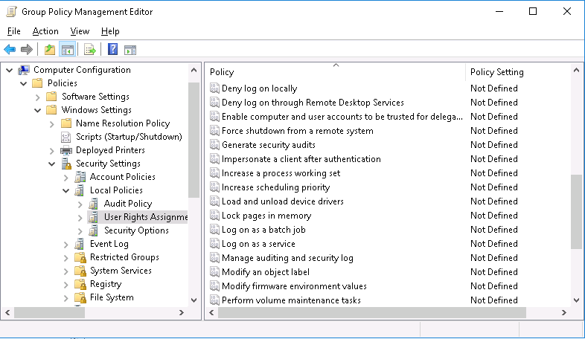
Configuring user rights

Slide 14
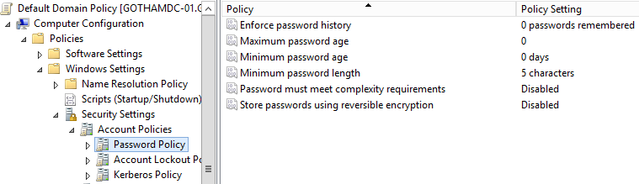
Policies - Password

Slide 15
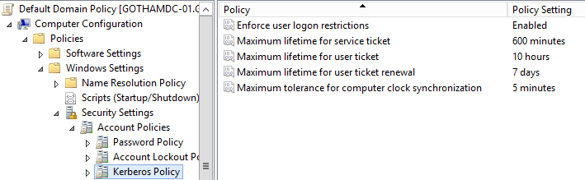
Policies - Kerberos

Slide 16
JEA - Just Enough Administration
JEA provides RBAC on Windows PowerShell remoting
The endpoint limits the user to use predefined PowerShell cmdlets, parameters, and parameter values
Actions are performed by using a special machine local virtual account
Native support in Windows Server 2016 and Windows 10
Supported on other OS with installed WMF 5+

Slide 17
JEA - Disadvantages
Not suitable for troubleshooting tasks
Setup requires understanding precisely which cmdlets, parameters, aliases, and values are needed to perform specific tasks
JEA works only with Windows PowerShell sessions
User must be familiar with PowerShell

Slide 18
JEA - Configuring
Create role-capability file(s)
Configure visible cmdlets
Configure visible functions
Configure visible external commands
Create session-configuration file(s)
Configure role defitinions
Creating JEA endpoint / Register session-configuration file(s)
Connect to JEA endpoint
Enter-PSSession -ComputerName $ -ConfigurationName $

Slide 19
JEA - DEMO

Slide 20
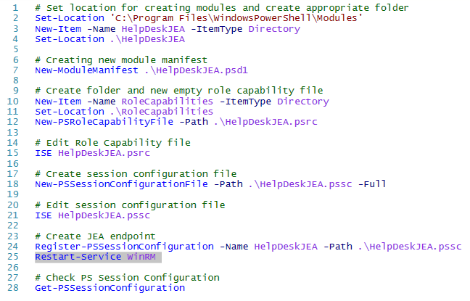
JEA - Screenshots

Slide 21
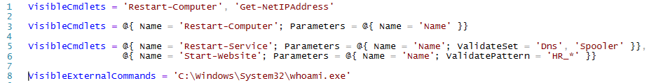
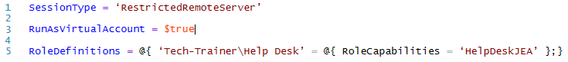
JEA - Screenshots
Edit role-capability file
Edit session-configuration file

Slide 22
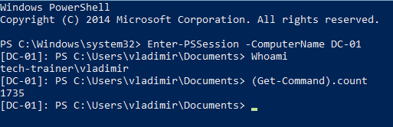
JEA - Screenshots

Slide 23
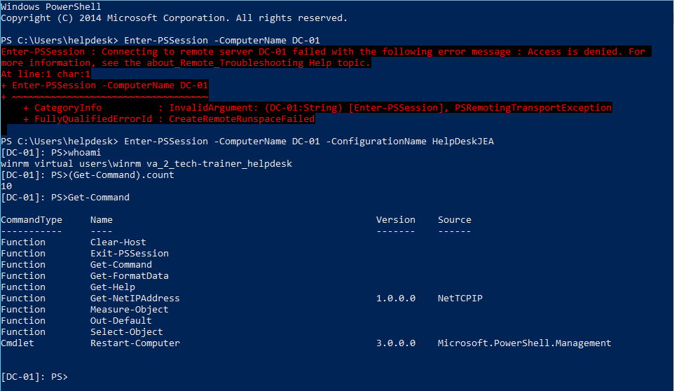
JEA - Screenshots

Slide 24
We must not forget
a.k.a. Oldie Goldie principles

Slide 25
Oldie goldie
System patching
Backup & Backup testing
Password & Kerberos policy
Disable SMBv1 (be careful, sensitive task)
Disable NTLM (be careful)
Least privilege
Separated admin account
...

Slide 26
Q & A

Slide 27
Thank you for your attention
Go to lunch ! ! !

Slide 28
31.08 – 01.09.2018. Osijek

